Slide 1
High-speed imaging
Claus-Dieter Ohl

Slide 2
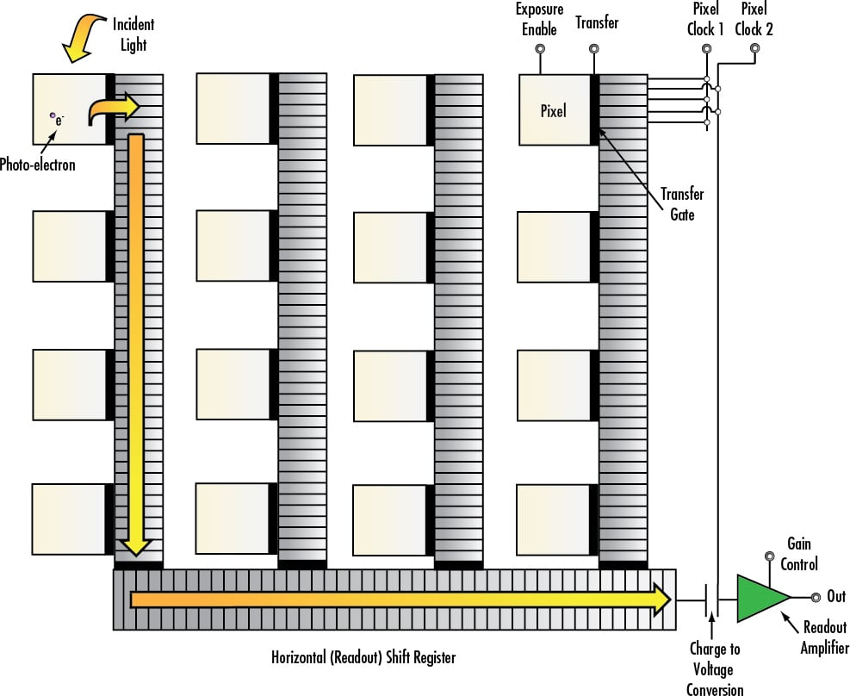
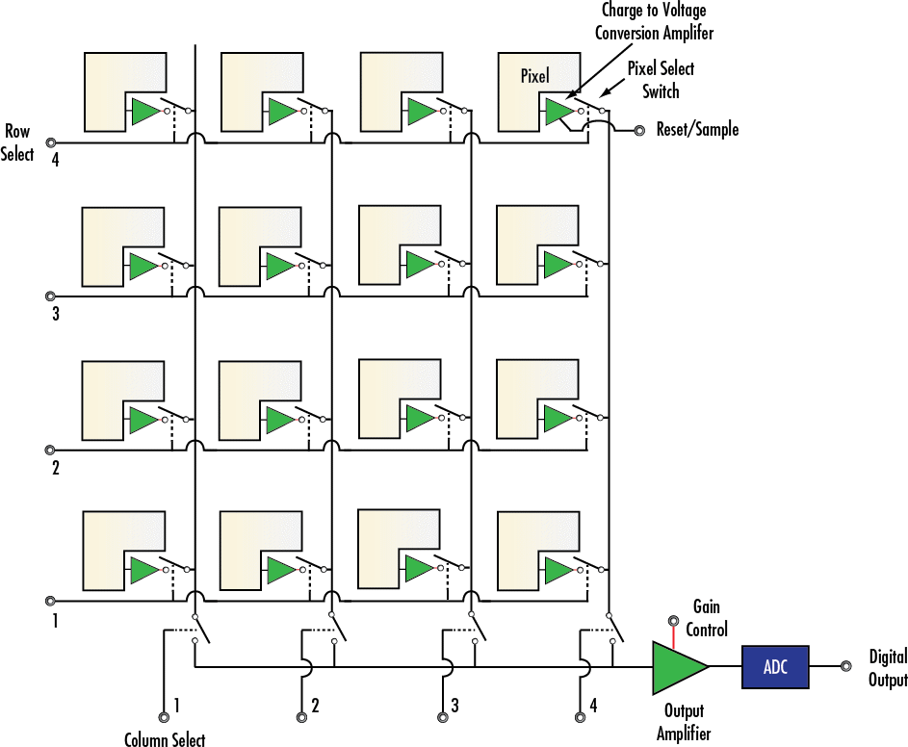
CCD vs. CMOS sensors

Slide 3
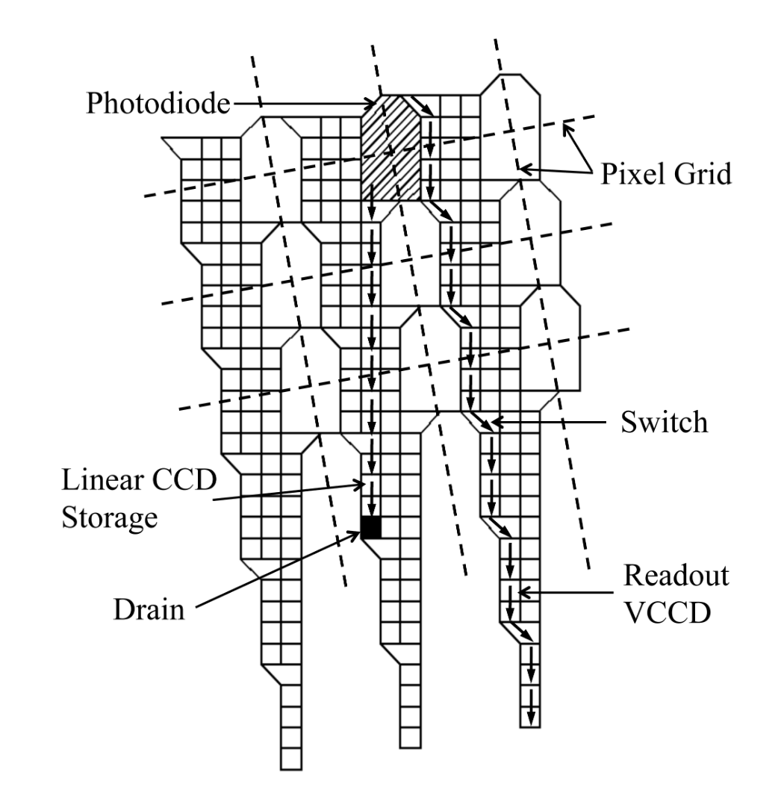
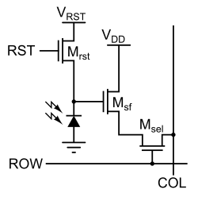
Single CMOS pixels
Storage CCD sensor
of the Shimadzu HPV 1
https://en.wikipedia.org/wiki/Active-pixel_sensor

Slide 4
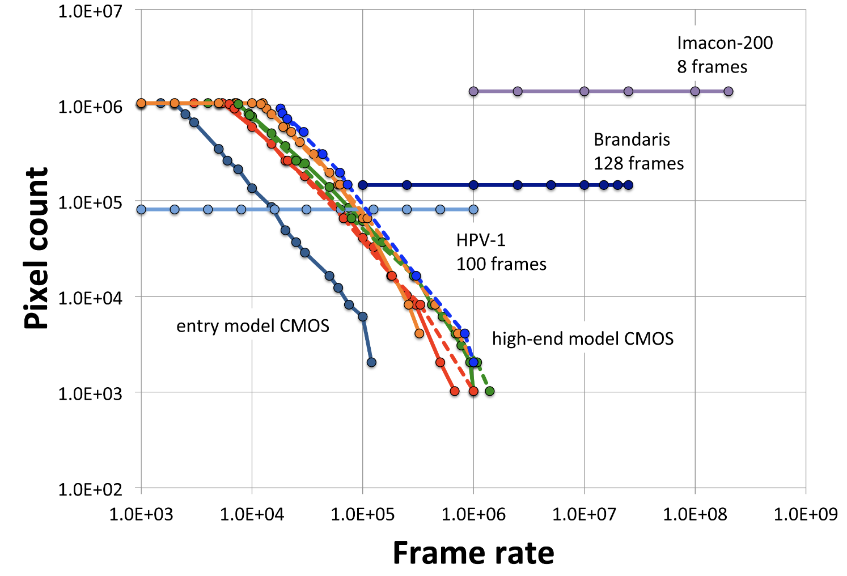
Full frame, CMOS and single image cameras
HPV X-2
128 frames
Pharsighted
continous imaging
M. Versluis, Exp. Fluids (2013)

Slide 5
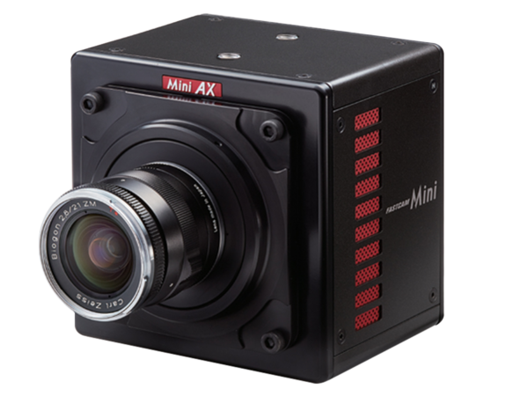
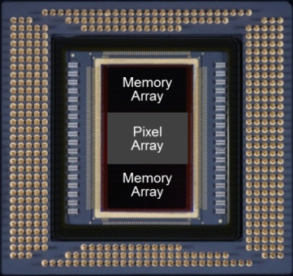
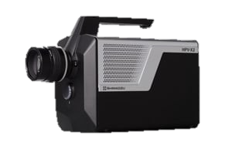
CMOS based high-speed cameras
Photron Mini AX200:
Up to 900,000 frames/s
Shimadzu HPV X-2
Up to 10 million frames/s

Slide 6
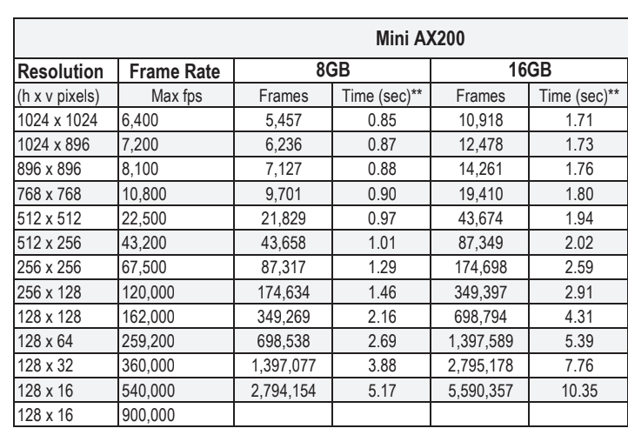

Slide 7
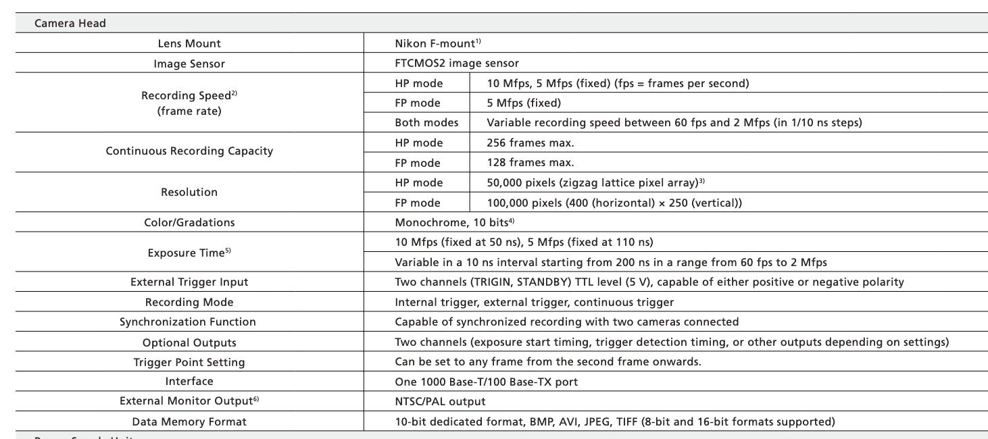
Shimadzu HPV X-2

Slide 8
